Slide 1
Towards Privacy-Preserving and PracticaL Image-Centric SociaL Discovery
IEEE TRANSACTIONS ON DEPENDABLE AND SECURE COMPUTING, VOL. 15, NO. 5, SEPTEMBER/OCTOBER 2018
Joe H.Zhu

Slide 2
Background
Uploaded images contain rich information
To effectively handle the large-scale computation and storage many social media applications is to adopt the public cloud platforms
Current protection mechanisms primarily focus on traditional access control
The public cloud is known to have a very broad attack surface
Joe H.Zhu

Slide 3
contributions
Our proposed secure index structure guarantees the privacy protection on image content and user image profiles.
We extend the system functionality by supporting secure insertion and secure deletion for the updates of user image profiles.
Joe H.Zhu

Slide 4
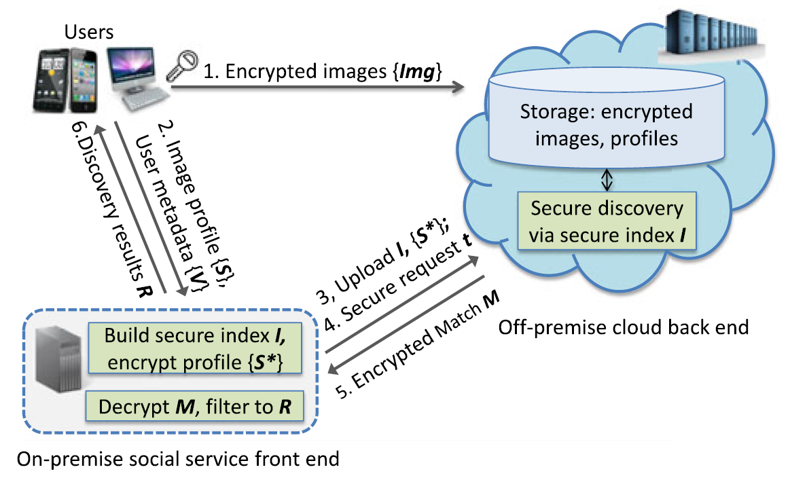
system architecture
Joe H.Zhu

Slide 5
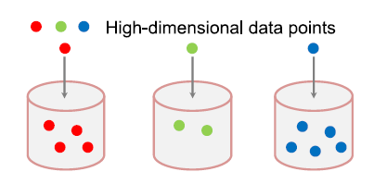
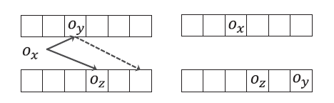
Preliminaries
Locality-sensitive Hashing (LSH)
Cuckoo Hashing
Joe H.Zhu

Slide 6

User
CS
User Image Profile Generation {S}
SF
Encrypted images
User Metadata Generation {V}
Encrypted profiles
Encrypts images {Img}
CS
Secure index I
Discovery & Encrypted match M
SF
SF
Build & Rebuild secure index I
CS
Encrypt profile {$S^{∗}$}
Secure request trapdoor t
Decrypt M, filter to R
User
Joe H.Zhu

Slide 7
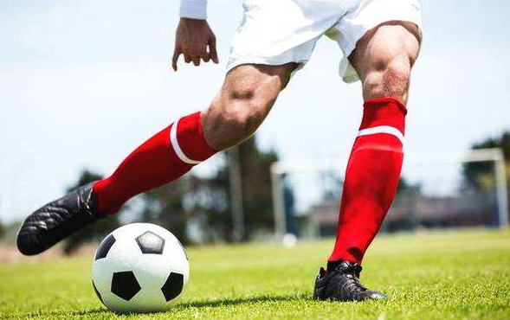





User
Bag-of-words模型
the visual word vocabulary △
SIFT
the image feature vectors
the visual words
SURF
K-means clustering
Bow vector 1： W = {$w_{1}$ , $w_{2}$,,,,, $w_{m}$}
normalizes it
Bow vector 2： W = {$w_{1}$ , $w_{2}$,,,,, $w_{m}$}
the user image profile vector：
S = {$s_{1}$ , $s_{2}$,,,,, $s_{m}$}
Bow vector 3： W = {$w_{1}$ , $w_{2}$,,,,, $w_{m}$}
…
Bow vector n： W = {$w_{1}$ , $w_{2}$,,,,, $w_{m}$}
Note:the visual word vocabulary △ be pre-trained by SF and provisioned to each user client.
where $s_{i}$ reflects the strength of user’s preference on the ith visual word in △.
$w_{i}$denotes the occurrences of the corresponding visual word m is the cardinality of △
Joe H.Zhu

Slide 8

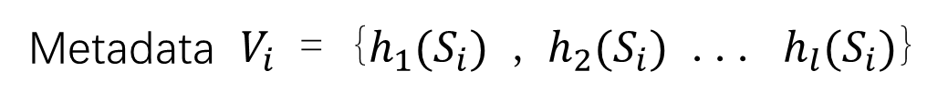
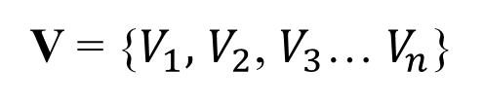
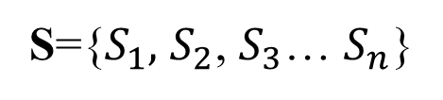
For n users
S={$S_{1},$ $S_{2}$, $S_{3}$… $S_{n}$}
V = {$V_{1},$ $V_{2}$, $V_{3}$… $V_{n}$}
Metadata $V_{i}$ = {$h_{1}(S_{i})$ , $h_{2}(S_{i})$ ... $h_{l}(S_{i})$}
The parameter h = {$h_{1}$, $h_{2}$... $h_{l}$} denotes the set parameters of l concatenation LSH functions
metadata V uploaded directly to SF.
Joe H.Zhu

Slide 9
d = 2
L层
…
N=L*w
w
Joe H.Zhu

Slide 10

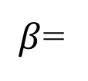


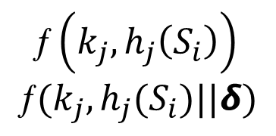





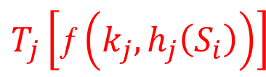
SF
d = 2
1≤i≤n users
$${k_{1} h}_{1}( )$$
$$\text{ƒ}\left(k_{j},h_{j}\left(S_{i}\right)\right)$$
$$\text{ƒ}(k_{j},h_{j}(S_{i})||δ)$$
Random j 1≤j≤L
$β$=
$${k_{2} h}_{2}( )$$
$${k_{j} h}_{j}( )$$
$$T_{j}\left[\text{ƒ}\left(k_{j},h_{j}\left(S_{i}\right)\right)\right]$$
$T_{j}[β]$
$${k_{j+1} h}_{j+1}( )$$
$$T_{j}[\text{ƒ}(k_{j},h_{j}(S_{i})||δ)]$$
…
Random j 1≤j≤L
$${k_{L} h}_{L}( )$$
$$S_{i} \text{−>}β\text{−>}T_{j}\left[β\right]=L_{i}$$
Joe H.Zhu

Slide 11



SF
d = 2
1≤i≤n users
$${k_{1} h}_{1}( )$$
$$\text{ƒ}\left(k_{j},h_{j}\left(S_{i}\right)\right)$$
$$\text{ƒ}(k_{j},h_{j}(S_{i})||δ)$$
Random j 1≤j≤L
$β$=
$${k_{2} h}_{2}( )$$
$${k_{j} h}_{j}( )$$
 |  |  | $$L_{i}$$
$$T_{j}\left[\text{ƒ}\left(k_{j},h_{j}\left(S_{i}\right)\right)\right]$$
$T_{j}[β]$
$${k_{j+1} h}_{j+1}( )$$
$$T_{j}[\text{ƒ}(k_{j},h_{j}(S_{i})||δ)]$$
…
$$δ ∈[1,d]$$
Random j 1≤j≤L
$${k_{L} h}_{L}( )$$
$$S_{i} \text{−>}β\text{−>}T_{j}\left[β\right]=l_{i}$$
Primary insertion
Joe H.Zhu

Slide 12






SF
d = 2
Randomly α [1,L]
[α mod L, α +L-1 mod L]
$${k_{1} h}_{1}( )$$
 |  |  | $$L_{1}$$
$${k_{2} h}_{2}( )$$
 |  | $$L_{i}$$ |  |  |  |  |  | $$L_{3}$$
Example:
[1,2,3,4,5,6,7]
$$L_{i}$$
$${k_{j} h}_{j}( )$$
 |  |  | $$L_{4}$$
Random j=3 1≤j≤L
$${k_{j+1} h}_{j+1}( )$$
 |  |  |  |  | $$L_{7}$$
[1,2,3,4,5,6,7]
…
$${k_{L} h}_{L}( )$$
 |  |  |  |  | $$L_{9}$$
Random probe
Joe H.Zhu

Slide 13







SF
d = 2
$$S_{16}$$
Random j=2 1≤j≤L
 | $$L_{5}$$ |  | $$L_{1}$$ | $$L_{6}$$
$$L_{16}$$
$${k_{1} h}_{1}( )$$
$${k_{2} h}_{2}( )$$
 |  | $$L_{2}$$ |  |  |  | $$L_{8}$$ |  | $$L_{3}$$
$${k_{j} h}_{j}( )$$
 | $$L_{13}$$ |  | $$L_{4}$$ |  |  |  |  | $$L_{14}$$
$${k_{j+1} h}_{j+1}( )$$
 |  |  | $$L_{12}$$ | $$L_{10}$$ | $$L_{7}$$
…
$${k_{L} h}_{L}( )$$
 |  |  |  | $$L_{11}$$ | $$L_{9}$$ | $$L_{15}$$
Cuckoo kick-away
Joe H.Zhu

Slide 14





SF
d = 2
$$S_{16}$$
Random j=2 1≤j≤L
 | $$L_{5}$$ |  | $$L_{1}$$ | $$L_{6}$$
$$L_{16}$$
$${k_{1} h}_{1}( )$$
$${k_{2} h}_{2}( )$$
 |  | $$L_{2}$$ |  |  |  | $$L_{8}$$ |  | $$L_{3}$$
$${k_{j} h}_{j}( )$$
 | $$L_{13}$$ |  | $$L_{4}$$ |  |  |  |  | $$L_{14}$$
$$L_{3}$$
Random j=L 1≤j≤L
$${k_{j+1} h}_{j+1}( )$$
 |  |  | $$L_{12}$$ | $$L_{10}$$ | $$L_{7}$$
…
$${k_{L} h}_{L}( )$$
 |  |  |  | $$L_{11}$$ | $$L_{9}$$ | $$L_{15}$$
Cuckoo kick-away
Joe H.Zhu

Slide 15


SF
d = 2
$$S_{16}$$
Random j=2 1≤j≤L
 | $$L_{5}$$ |  | $$L_{1}$$ | $$L_{6}$$
$$L_{16}$$
$${k_{1} h}_{1}( )$$
$${k_{2} h}_{2}( )$$
 |  | $$L_{2}$$ |  |  |  | $$L_{8}$$ |  | $$L_{16}$$
$${k_{j} h}_{j}( )$$
 | $$L_{13}$$ |  | $$L_{4}$$ |  |  |  |  | $$L_{14}$$
$$L_{3}$$
Random j=L 1≤j≤L
$${k_{j+1} h}_{j+1}( )$$
 |  |  | $$L_{12}$$ | $$L_{10}$$ | $$L_{7}$$
…
$${k_{L} h}_{L}( )$$
 |  |  |  | $$L_{11}$$ | $$L_{9}$$ | $$L_{15}$$ | $$L_{3}$$
Cuckoo kick-away
Joe H.Zhu

Slide 16





SF
d = 2
$${k_{1} h}_{1}( )$$
 | $$L_{5}$$ | $$L_{21}$$ | $$L_{1}$$ | $$L_{6}$$ | $$L_{16}$$ |  | $$L_{26}$$ | $$L_{25}$$ | $$L_{24}$$
$${k_{2} h}_{2}( )$$
$$L_{29}$$ |  | $$L_{2}$$ | $$L_{28}$$ | $$L_{27}$$ | $$L_{17}$$ | $$L_{8}$$ |  | $$L_{16}$$
$$L_{33}$$ | $$L_{13}$$ |  | $$L_{4}$$ |  |  | $$L_{18}$$ | $$L_{34}$$ | $$L_{14}$$ | $$L_{23}$$
N-n
$${k_{j} h}_{j}( )$$
str
$${k_{j+1} h}_{j+1}( )$$
 | $$L_{30}$$ |  | $$L_{12}$$ | $$L_{10}$$ | $$L_{7}$$ | $$L_{35}$$ | $$L_{19}$$ |  | $$L_{22}$$
…
$${k_{L} h}_{L}( )$$
$$L_{32}$$ |  | $$L_{31}$$ |  | $$L_{11}$$ | $$L_{9}$$ | $$L_{15}$$ | $$L_{3}$$ |  | $$L_{20}$$
Random padding
Joe H.Zhu

Slide 17
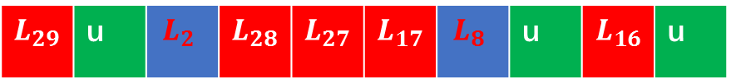

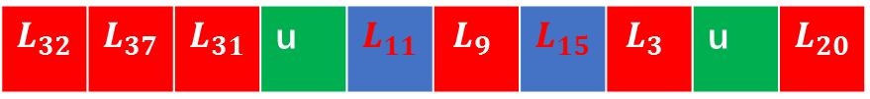
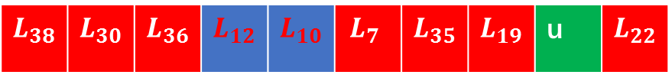
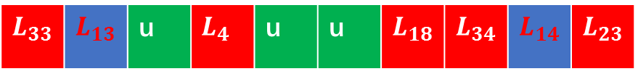
SF
d = 2
$${k_{1} h}_{1}( )$$
u | $$L_{5}$$ | $$L_{21}$$ | $$L_{1}$$ | $$L_{6}$$ | $$L_{16}$$ | u | $$L_{26}$$ | $$L_{25}$$ | $$L_{24}$$
1≤i≤n users
$${k_{2} h}_{2}( )$$
$$L_{29}$$ | u | $$L_{2}$$ | $$L_{28}$$ | $$L_{27}$$ | $$L_{17}$$ | $$L_{8}$$ | u | $$L_{16}$$ | u
$${k_{j} h}_{j}( )$$
$$L_{33}$$ | $$L_{13}$$ | u | $$L_{4}$$ | u | u | $$L_{18}$$ | $$L_{34}$$ | $$L_{14}$$ | $$L_{23}$$
N-n
L层
$${k_{j+1} h}_{j+1}( )$$
$$L_{38}$$ | $$L_{30}$$ | $$L_{36}$$ | $$L_{12}$$ | $$L_{10}$$ | $$L_{7}$$ | $$L_{35}$$ | $$L_{19}$$ | u | $$L_{22}$$
u bits random strings
…
$${k_{L} h}_{L}( )$$
$$L_{32}$$ | $$L_{37}$$ | $$L_{31}$$ | u | $$L_{11}$$ | $$L_{9}$$ | $$L_{15}$$ | $$L_{3}$$ | u | $$L_{20}$$
N=L*w
w
Random padding
Joe H.Zhu

Slide 18
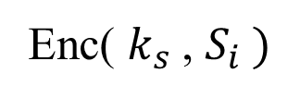

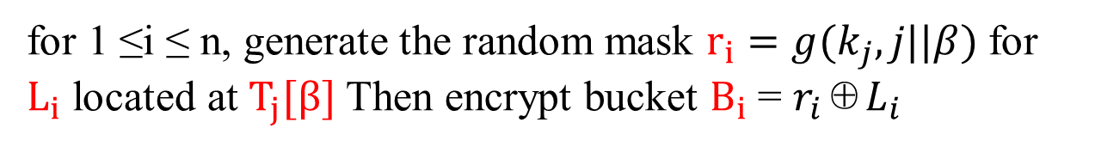
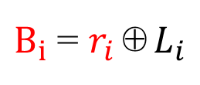





SF
V = {$h_{1}(S)$ , $h_{2}(S)$ ... $h_{l}(S)$}
for 1 ≤i ≤ n, generate the random mask $r_{i}=g(k_{j},j||β)$for $L_{i}$ located at $T_{j}[β]$ Then encrypt bucket $B_{i}$ = $r_{i}$⊕$L_{i}$
$V_{i}$ = $h_{j}(S_{i})$
$B_{i}$ = $r_{i}$⊕$L_{i}$
$$r_{i}=g(k_{j},j||β)$$
$$β\text{=}\text{ƒ}(k_{j},h_{j}(S_{i}))$$
$T_{j}[β]$
Bucket encryption
Enc( $k_{s}$, $S_{i} )$
$$S_{i}^{∗}$$
Joe H.Zhu
Image profile encryption

Slide 19

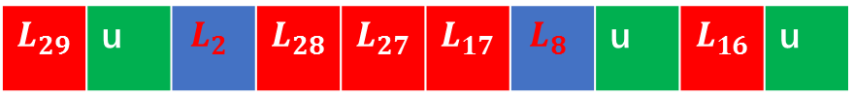


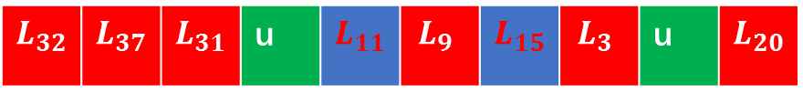
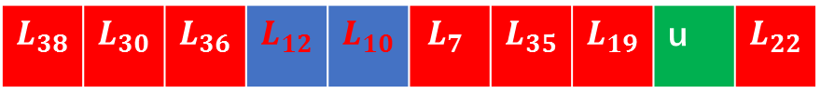
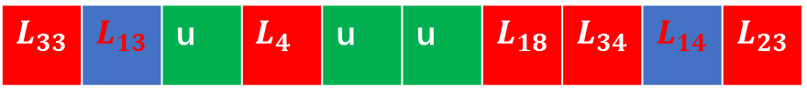
SF
u | $$L_{5}$$ | $$L_{21}$$ | $$L_{1}$$ | $$L_{6}$$ | $$L_{16}$$ | u | $$L_{26}$$ | $$L_{25}$$ | $$L_{24}$$
$$L_{29}$$ | u | $$L_{2}$$ | $$L_{28}$$ | $$L_{27}$$ | $$L_{17}$$ | $$L_{8}$$ | u | $$L_{16}$$ | u
$$L_{33}$$ | $$L_{13}$$ | u | $$L_{4}$$ | u | u | $$L_{18}$$ | $$L_{34}$$ | $$L_{14}$$ | $$L_{23}$$
$$L_{38}$$ | $$L_{30}$$ | $$L_{36}$$ | $$L_{12}$$ | $$L_{10}$$ | $$L_{7}$$ | $$L_{35}$$ | $$L_{19}$$ | u | $$L_{22}$$
$${\{S}_{i}^{∗}\}$$
1≤i≤n users
…
$$L_{32}$$ | $$L_{37}$$ | $$L_{31}$$ | u | $$L_{11}$$ | $$L_{9}$$ | $$L_{15}$$ | $$L_{3}$$ | u | $$L_{20}$$
Index I
Joe H.Zhu

Slide 20

$${\{S}_{i}^{∗}\}$$
Index I
SF
CS
Joe H.Zhu

Slide 21

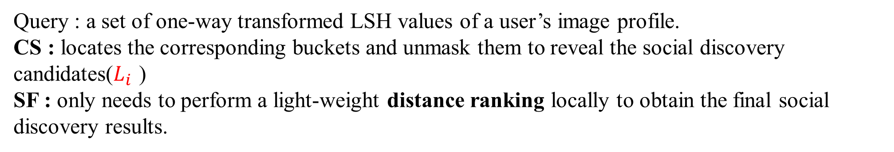

Social Discovery
Motivation:
1. Users actively want to add friends
2. Service providers actively want to recommend friends
Query(t)
$$S$$
$${\{S}_{i}^{∗}\}$$
SF
CS
V
Index I
the matched encrypted image profiles M
Query : a set of one-way transformed LSH values of a user’s image profile.
CS : locates the corresponding buckets and unmask them to reveal the social discovery candidates($L_{i}$ )
SF : only needs to perform a light-weight distance ranking locally to obtain the final social discovery results.
Joe H.Zhu

Slide 22
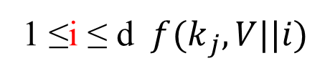
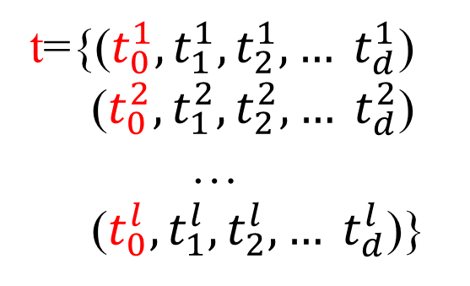

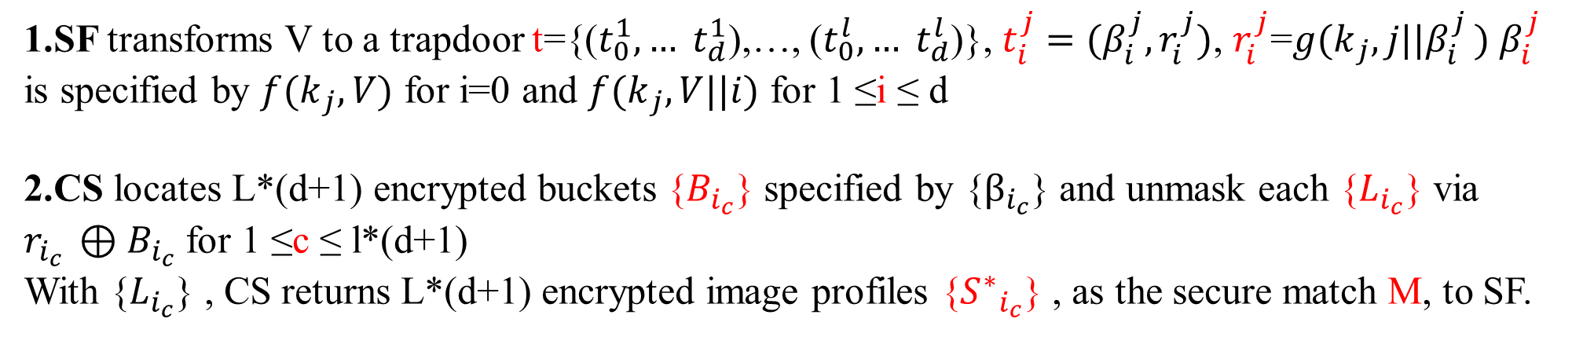
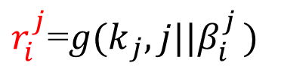

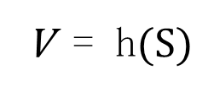

1.SF transforms V to a trapdoor t={($t_{0}^{1},… t_{d}^{1}$),…, ($t_{0}^{l},… t_{d}^{l}$)}, $t_{i}^{j}=(β_{i}^{j},r_{i}^{j})$, $r_{i}^{j}$=${g(k}_{j}{,j||β}_{i}^{j}) β_{i}^{j}$ is specified by ${f(k}_{j},V)$ for i=0 and ${f(k}_{j},V||i)$ for 1 ≤i ≤ d
2.CS locates L*(d+1) encrypted buckets {$B_{i_{c}}$} specified by {$β_{i_{c}}$} and unmask each {$L_{i_{c}}$} via $r_{i_{c} }{⊕B}_{i_{c}}$ for 1 ≤c ≤ l*(d+1)
With {$L_{i_{c}}$} , CS returns L*(d+1) encrypted image profiles {${S^{∗}}_{i_{c}}$} , as the secure match M, to SF.
j row
i Column
t={($t_{0}^{1},t_{1}^{1},t_{2}^{1}, … t_{d}^{1}$)
($t_{0}^{2},t_{1}^{2},t_{2}^{2}, … t_{d}^{2}$)
…
($t_{0}^{l},t_{1}^{l},t_{2}^{l}, … t_{d}^{l}$)}
$$t_{i}^{j}=(β_{i}^{j},r_{i}^{j})$$
l*(d+1)
${\text{i}\text{=0} f(k}_{j},V)$
${=β}_{i}^{j}$
$r_{i}^{j}$=${g(k}_{j}{,j||β}_{i}^{j})$
1 ≤i ≤ d ${f(k}_{j},V||i)$
V = h$(S)$
Joe H.Zhu

Slide 23
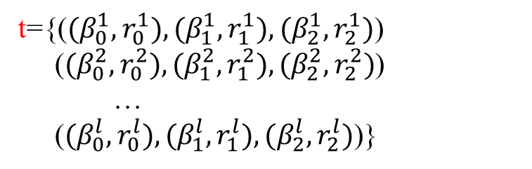

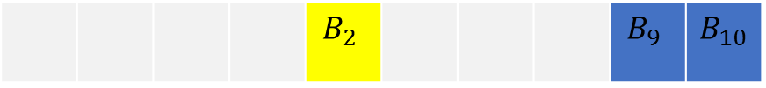
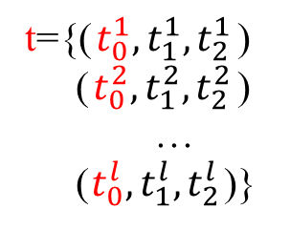








d = 2
$$V_{6}$$
t={($t_{0}^{1},t_{1}^{1},t_{2}^{1}$)
($t_{0}^{2},t_{1}^{2},t_{2}^{2}$)
…
($t_{0}^{l},t_{1}^{l},t_{2}^{l}$)}
$${k_{1} h}_{1}( )$$
 |  | $$B_{7}$$ | $$B_{1}$$ |  |  | $$B_{8}$$
L*(d+1)
$${k_{2} h}_{2}( )$$
 |  |  |  | $$B_{2}$$ |  |  |  | $$B_{9}$$ | $$B_{10}$$
展开：
$${k_{j} h}_{j}( )$$
 | $$B_{3}$$ |  |  | $$B_{11}$$ |  |  | $$B_{12}$$
t={($(β_{0}^{1},r_{0}^{1}),(β_{1}^{1},r_{1}^{1}),(β_{2}^{1},r_{2}^{1})$)
($(β_{0}^{2},r_{0}^{2}),(β_{1}^{2},r_{1}^{2}),(β_{2}^{2},r_{2}^{2})$)
…
($(β_{0}^{l},r_{0}^{l}),(β_{1}^{l},r_{1}^{l}),(β_{2}^{l},r_{2}^{l})$)}
$${k_{j+1} h}_{j+1}( )$$
 |  | $$B_{13}$$ |  | $$B_{16}$$ |  | $$B_{4}$$
…
加密桶：
$B_{i}$ = $r_{i}$⊕$L_{i}$
$${k_{L} h}_{L}( )$$
 |  |  |  | $$B_{14}$$ | $$B_{6}$$ |  |  | $$B_{15}$$
$$r_{i}=g(k_{j},j||β)$$
$L_{i}$= $r_{i}$⊕$B_{i}$
$$β\text{=}\text{ƒ}(k_{j},h_{j}(S_{i}))$$
Joe H.Zhu

Slide 24

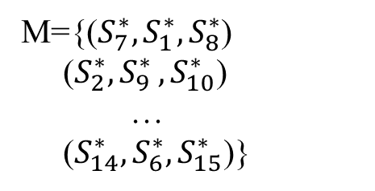

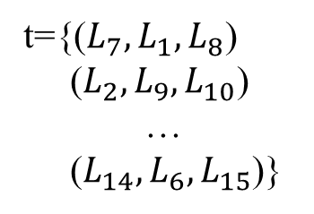

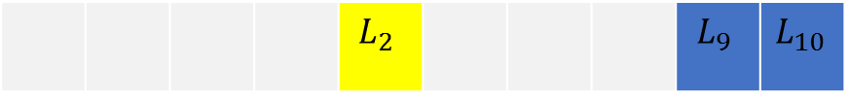

d = 2
t={($L_{7},L_{1},L_{8}$)
($L_{2},L_{9},L_{10}$)
…
($L_{14},L_{6},L_{15}$)}
$${k_{1} h}_{1}( )$$
 |  | $$L_{7}$$ | $$L_{1}$$ |  |  | $$L_{8}$$
L*(d+1)
d = 2
$${k_{2} h}_{2}( )$$
 |  |  |  | $$L_{2}$$ |  |  |  | $$L_{9}$$ | $$L_{10}$$
$${k_{j} h}_{j}( )$$
 | $$L_{3}$$ |  |  | $$L_{11}$$ |  |  | $$L_{12}$$
M={($S_{7}^{∗},S_{1}^{∗},S_{8}^{∗}$)
($S_{2}^{∗}{,S}_{9}^{∗},S_{10}^{∗}$)
…
($S_{14}^{∗},S_{6}^{∗},S_{15}^{∗}$)}
$${k_{j+1} h}_{j+1}( )$$
 |  | $$L_{13}$$ |  | $$L_{16}$$ |  | $$L_{4}$$
L*(d+1)
d = 2
…
$${k_{L} h}_{L}( )$$
 |  |  |  | $$L_{14}$$ | $$L_{6}$$ |  |  | $$L_{15}$$
Joe H.Zhu

Slide 25
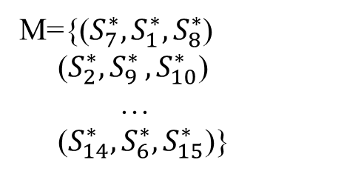
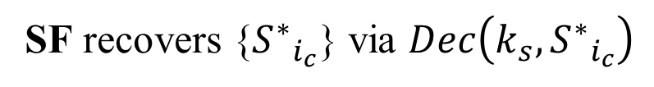
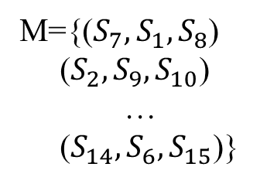
M
SF
CS
SF
M={($S_{7}^{∗},S_{1}^{∗},S_{8}^{∗}$)
($S_{2}^{∗}{,S}_{9}^{∗},S_{10}^{∗}$)
…
($S_{14}^{∗},S_{6}^{∗},S_{15}^{∗}$)}
SF recovers {${S^{∗}}_{i_{c}}$} via $Dec\left(k_{s},{S^{∗}}_{i_{c}}\right)$
M={($S_{7},S_{1},S_{8}$)
($S_{2},S_{9},S_{10}$)
…
($S_{14},S_{6},S_{15}$)}
distance ranking and filtering
1 | User 7
2 | User 3
3 | User 12
4 | User 8
L*(d+1)
R=
d = 2
R
SF
User 6
Joe H.Zhu

Slide 26



the user image profile vector：
S = {$s_{1}$ , $s_{2}$,,,,, $s_{m}$}
$$S_{6}$$
$$S_{i}$$
distance ranking and filtering
Joe H.Zhu

Slide 27








$${\{S}_{i}^{∗}\}$$
Index I
SF
CS
M
SK
{family}
ABE
User
{coworker}
AES
friends
R-key
…
{classmate}
PK
ABE
Joe H.Zhu

Slide 28
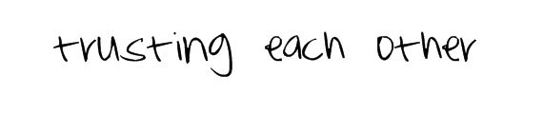
Joe H.Zhu

Slide 29
The end
Joe H.Zhu

Slide 30
Each user first generates ABE private keys for her friends individually based on different attributes, e.g., family, coworker,or classmate. Those attributes can be derived from user’s existing access control policy.
Then the client uses random keys to protect the uploaded images via symmetric encryption like AES. Meanwhile, the above image encryption keys are encrypted with ABE public key of the user. Only her friends with the proper ABE private keys can recover the image encryption key and decrypt the images.
As shown in our system framework, each user can manage the friendship and mandate the access policies of encrypted images, which preserves the existing functions of social media applications.
Joe H.Zhu

Slide 31
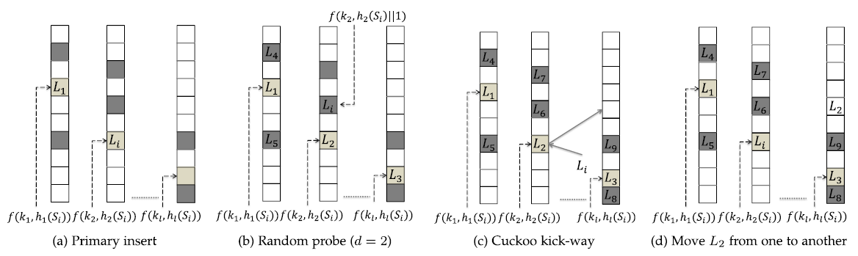
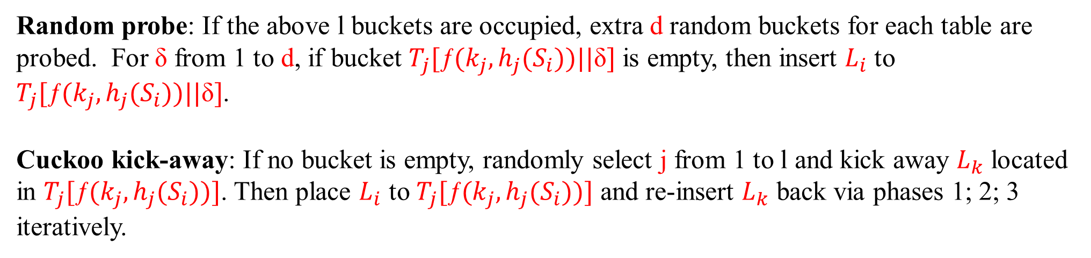
Random probe: If the above l buckets are occupied, extra d random buckets for each table are probed. For δ from 1 to d, if bucket $T_{j}[\text{ƒ}(k_{j},h_{j}(S_{i}))||\text{δ}]$ is empty, then insert $L_{i}$ to $T_{j}[\text{ƒ}(k_{j},h_{j}(S_{i}))||\text{δ}]$.
Cuckoo kick-away: If no bucket is empty, randomly select j from 1 to l and kick away $L_{k}$ located in $T_{j}[\text{ƒ}(k_{j},h_{j}(S_{i}))]$. Then place $L_{i}$ to $T_{j}[\text{ƒ}(k_{j},h_{j}(S_{i}))]$ and re-insert $L_{k}$ back via phases 1; 2; 3 iteratively.
Joe H.Zhu

Slide 32
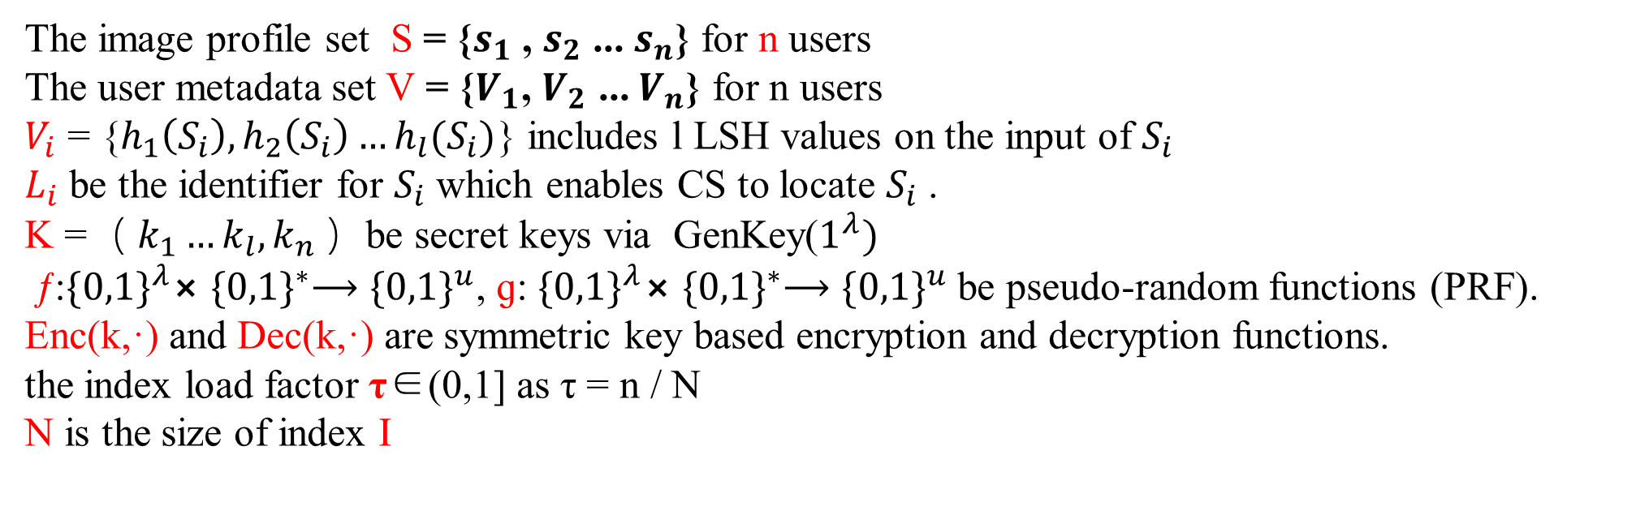
Setup phase:
1) Index initialization: Set the index load factor τ∈(0,1] as τ = n / N, N is the size of index I. Then create l hash tables. Each table T contains w =「 N/ l ｌ buckets, each bucket is u-bit length. Set the random probe range d for each table.
The image profile set S = {$s_{1}$ , $s_{2}$ ... $s_{n}$} for n users
The user metadata set V = {$V_{1}$, $V_{2}$ ... $V_{n}$} for n users
$V_{i}$ = {$h_{1}\left(S_{i}\right),h_{2}\left(S_{i}\right)…h_{l}(S_{i})$} includes l LSH values on the input of $S_{i}$
$L_{i}$ be the identifier for $S_{i}$ which enables CS to locate $S_{i}$ .
K =（ $k_{1}…k_{l},k_{n}$）be secret keys via GenKey($1^{λ})$
ƒ:${\{0,1\}}^{λ}⨯$ ${\{0,1\}}^{∗}⟶{\{0,1\}}^{u}$, ɡ: ${\{0,1\}}^{λ}⨯$ ${\{0,1\}}^{∗}⟶{\{0,1\}}^{u}$ be pseudo-random functions (PRF).
Enc(k,·) and Dec(k,·) are symmetric key based encryption and decryption functions.
the index load factor τ∈(0,1] as τ = n / N
N is the size of index I
Joe H.Zhu

Slide 33
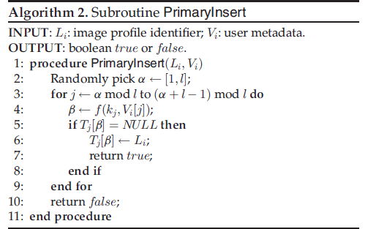
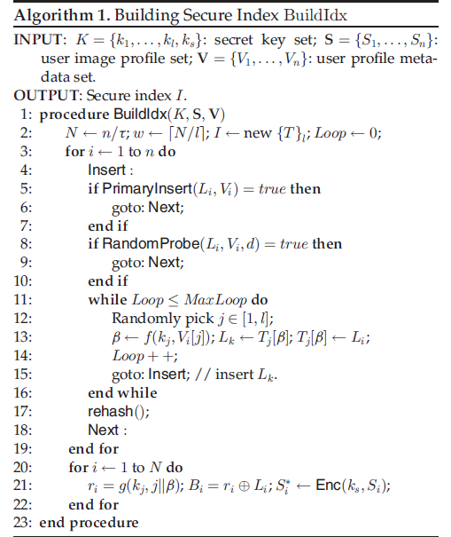
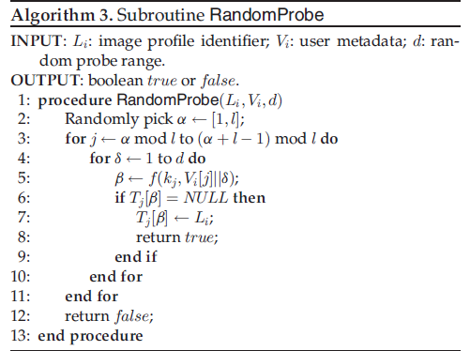
SF

